Slide 1


Wok Hey Bot
Sng Tian Hao, Keith
1273381F
t.me/wok_hey_bot

Slide 2
Overview
01.
02.
03.
04.
05.
06.
Introduction
Bot Flowchart
Intent
Entities & Parameters
Contexts & Rich Messages
Conclusion

Slide 3
01
Introduction

Slide 4

Introduction
After a long day at work, many commuters passing through Tanjong Pagar MRT stop by Wok Hey for a quick meal. However, ordering in person can sometimes be inconvenient, especially during peak hours. Recognising this challenge, Wok Hey Bot was developed as a personalised ordering assistant to enhance the customer experience.
With Wok Hey Bot, users can:
Browse the menu and explore customisation options.
Make enquiries about ingredients and meal choices.
Place remote orders for pickup or delivery, reducing wait times and streamlining the process.
Let’s take a closer look at how it works!

Slide 5
02
Bot Flowchart

Slide 6
Bot Architecture
Welcome
Legend
Store Location
Menu Information
Start/End of Dialogue
#confirm-order
#change-order
#place-order
Place Order
Intent
@Carbohydrates
@Protein
@Toppings
@Chilli
Change Address
Post-Intent Check Point
Change Order
#confirm-order
#change-order
#
Context
#confirm-delivery
#change-address
No
Check Order
@
Entity
No
Yes
#confirm-delivery
#change-address
Confirm Order
#delivery
Order Delivery
Check Address
Yes
Confirm Delivery
@Location
@Address
@Name
#confirm-collection
#change-location
#self-collect
#post-order-confirmation
Order Collection
#confirm-collection
#change-location
Thank You
Change Location
@StoreLocation
@Name
No
Check Location
Yes
Confirm Collection
#post-order-confirmation
Goodbye

Slide 7
03
Intents

Slide 8
Intents
A summary of all intents and their purposes embedded within the bot
Intent | Purpose
Welcome | Simple welcome and introduction on what Wok Hey Bot can do.
Store Location | Answers enquiries on where and when does Wok Hey operate.
Menu Information | Answers enquires on what does Wok Hey sell.
Place Order | Assist user with placing Wok Hey orders and confirms with user if order is correct.
Change Order | Re-takes user order if order was flagged as incorrect in “Place Order” intent.
Confirm Order | Checks if user would like to opt for delivery or self-collection.
Order Delivery | Consolidates delivery location and address of user and confirms with user if details are correct.
Change Address | Re-consolidate delivery location and address if details were flagged as incorrect in “Order Collection” intent.
Confirm Delivery | Sends a confirmation message on delivery details with ETA to user.
Order Collection | Consolidates preferred self-collection outlet and confirms with user if details are correct.
Change Location | Re-consolidate self-collection outlet if details were flagged as incorrect in “Order Collection” intent.
Confirm Collection | Sends a confirmation message on self-collection details with ETA to user.
Thank You | Responds to thank you messages and ends the conversation.
Goodbye | Responds to goodbye messages and ends the conversation.

Slide 9
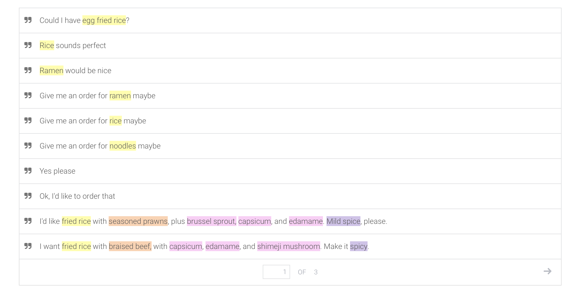
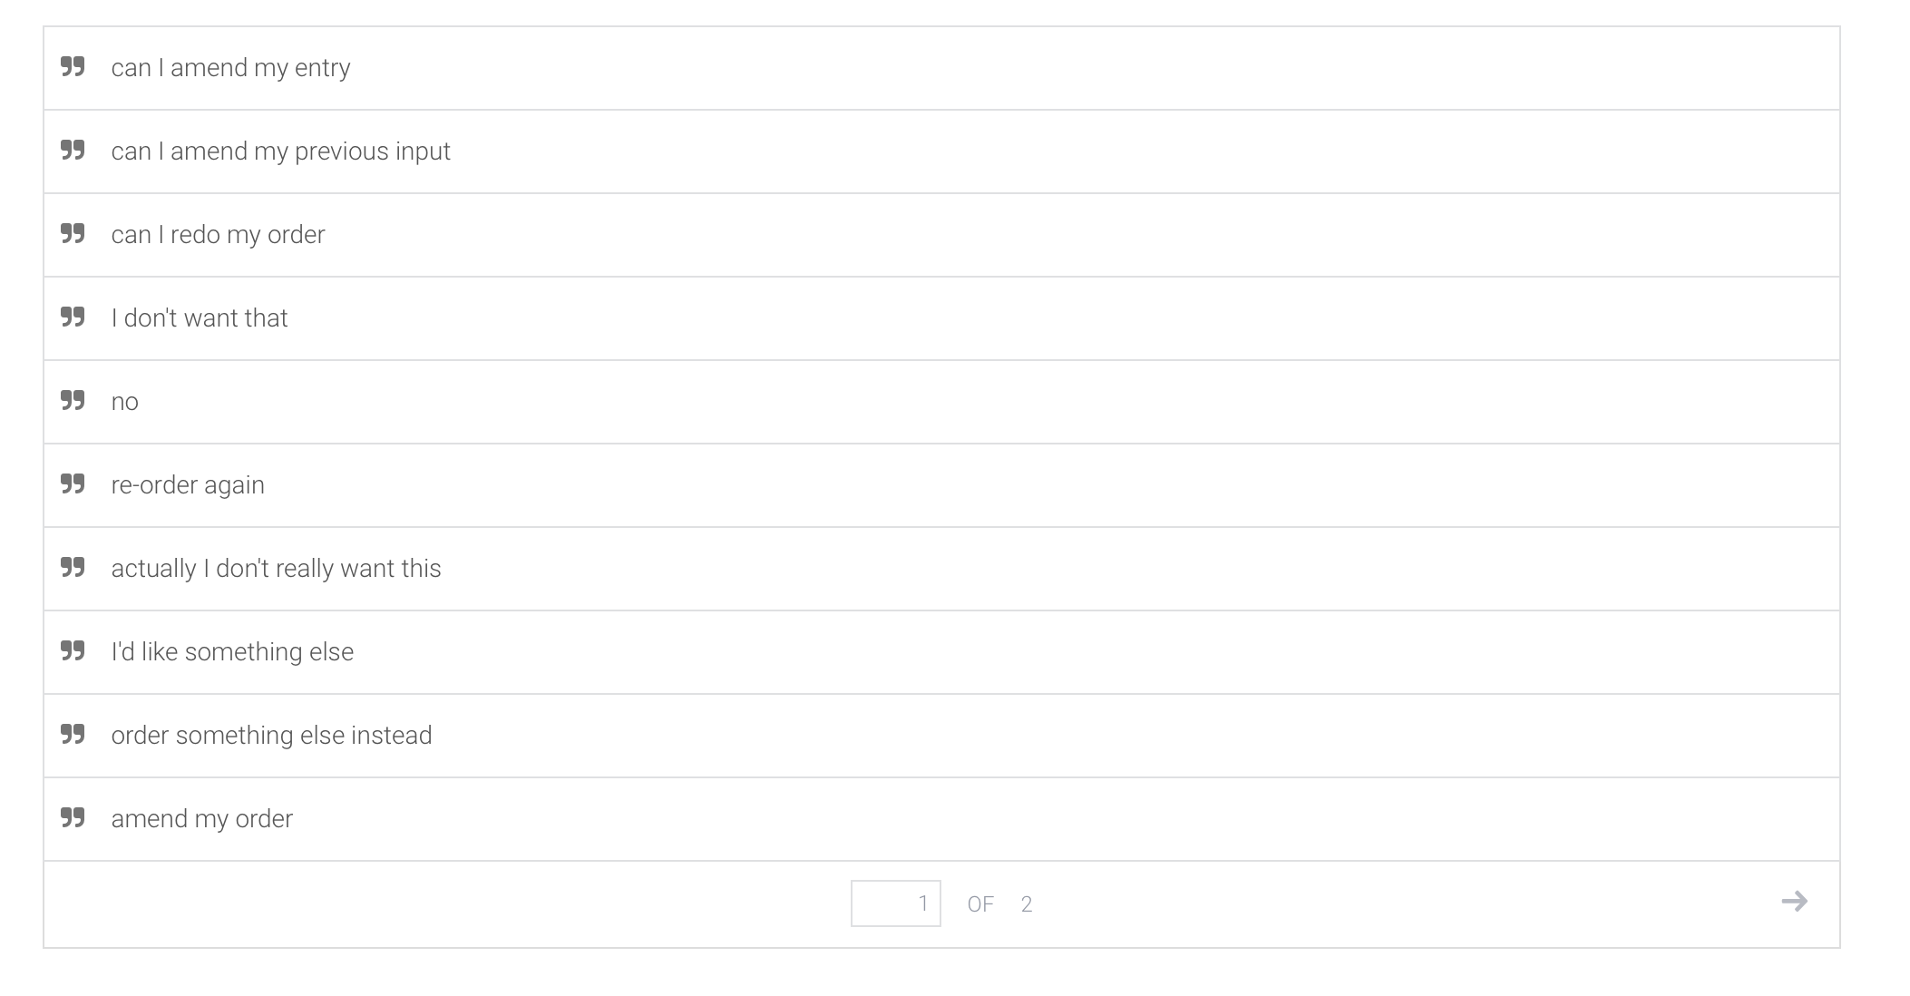
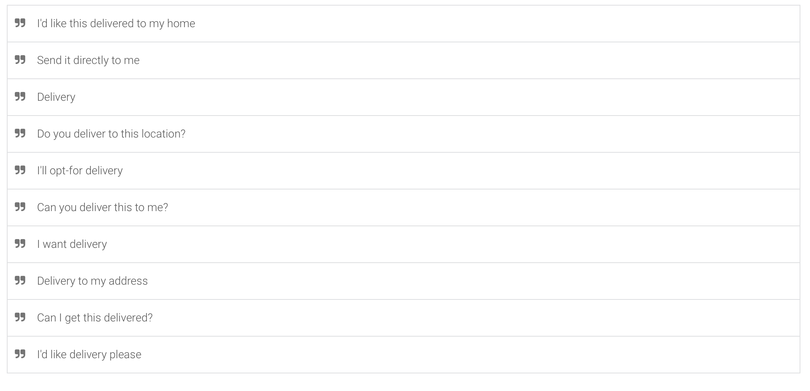
Sample Training Data
Place Order
Change Order
Order Delivery

Slide 10
04
Entities & Parameters

Slide 11
Entities
Carbohydrate
Protein
Toppings
Carbohydrate of choice for orders:
Egg fried rice
Stir-fried udon
Stir-fried ramen
…
Protein of choice for orders:
Grilled chicken
Braised beef
Seasoned prawns
Toppings of choice for orders:
Tobiko
Sous vide egg
Broccoli
…
Chilli
Store Locations
Location
Optional chilli add-on (with spice level) for orders:
Chilli
No chilli
Mild chilli
Spicy chilli
List of Wok Hey store locations for self-collection:
AMK Hub
Bugis Junction
Causeway Point
…
Nearest MRT station to locate user for delivery:
Ang Mo Kio
Bishan
Bukit Panjang
…

Slide 12
Parameters
Name
Address
Name of user for bot to address in replies to make conversation more personal
Full address of user for delivery, complete with block number, street name, unit number, and postal code

Slide 13
05
Contexts & Rich Messages

Slide 14
Contexts
A summary of all contexts and their purposes embedded within the bot
Context | Purpose
place-order | To flow user input from “Store Location” and “Menu Information” intent to “Place Order” intent.
change-order | To allow for user to change their orders after double checking their order at the end of “Place Order” intent.
delivery | To flow from “Confirm Order” intent to “Order Delivery” intent should user input delivery as response.
confirm-delivery | To flow from “Order Delivery” intent to “Confirm Delivery” intent should user confirm their input.
change-address | To allow for user to change their delivery location after double checking their delivery details at the end of “Order Delivery” intent.
self-collect | To flow from “Confirm Order” intent to “Order Collection” intent should user input delivery as response.
confirm-collection | To flow from “Order Collection” intent to “Confirm Collection” intent should user confirm their input.
change-location | To allow for user to change their self pick-up location after double checking their pick-up details at the end of “Order Collection” intent.
post-order-confirmation | To flow from “Confirm Collection” and “Confirm Delivery” intents to “Thank You” and “Goodbye” intents to end conversation.

Slide 15
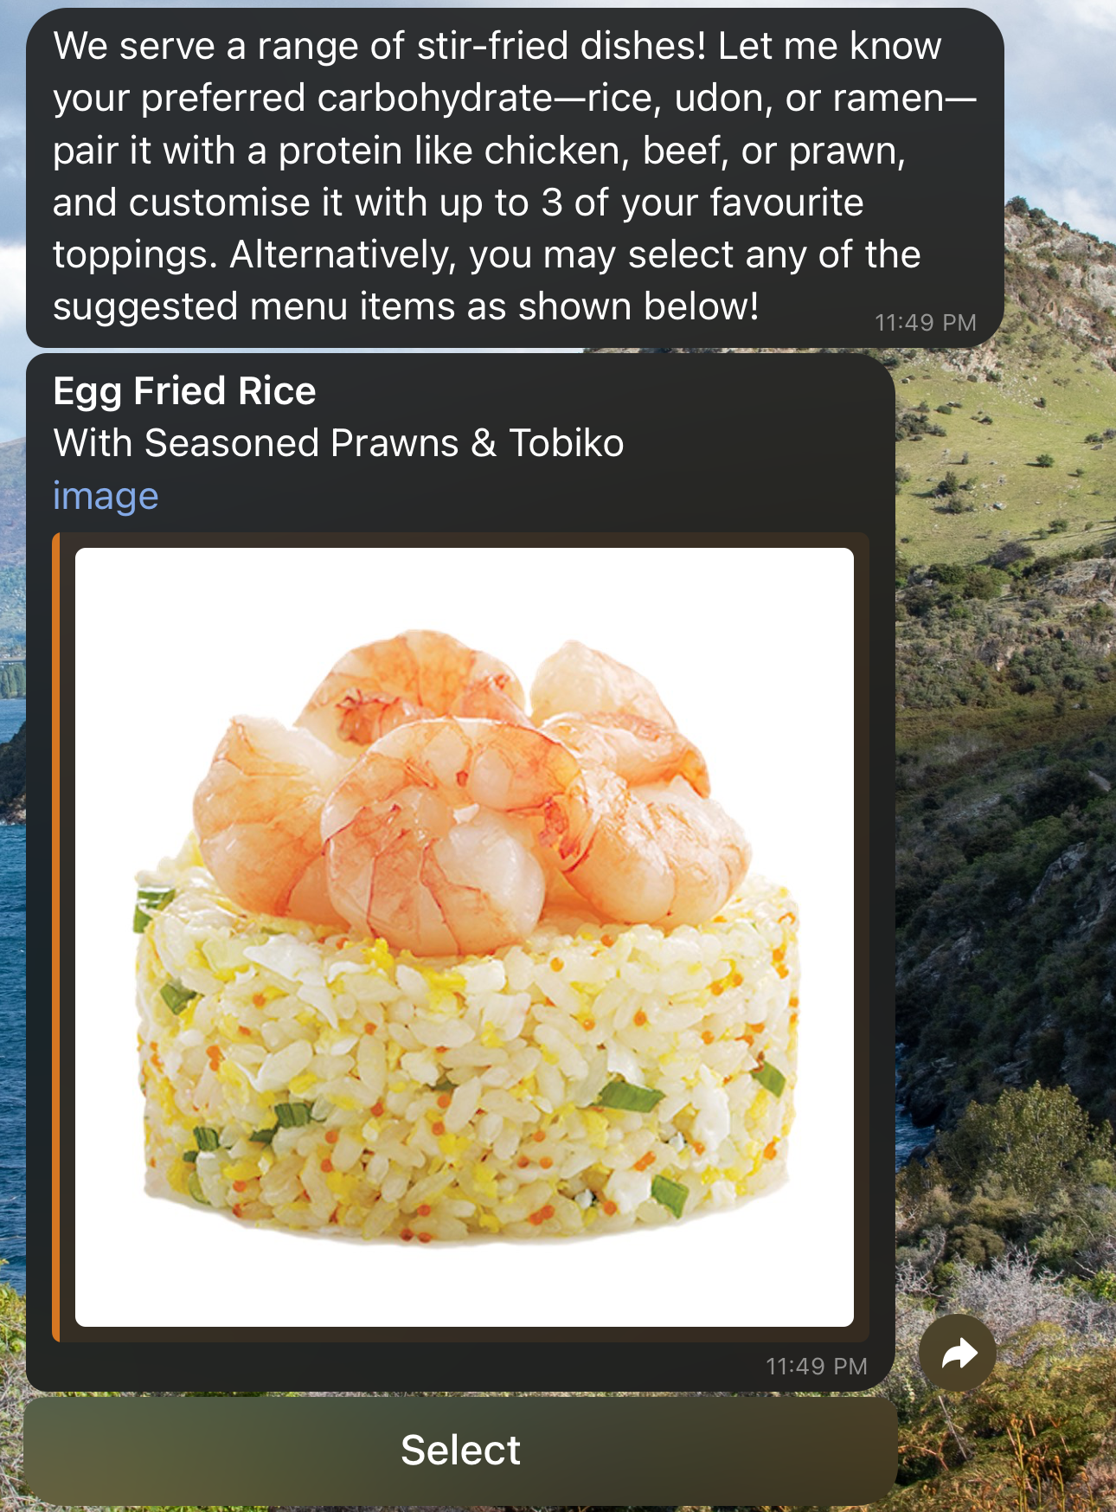
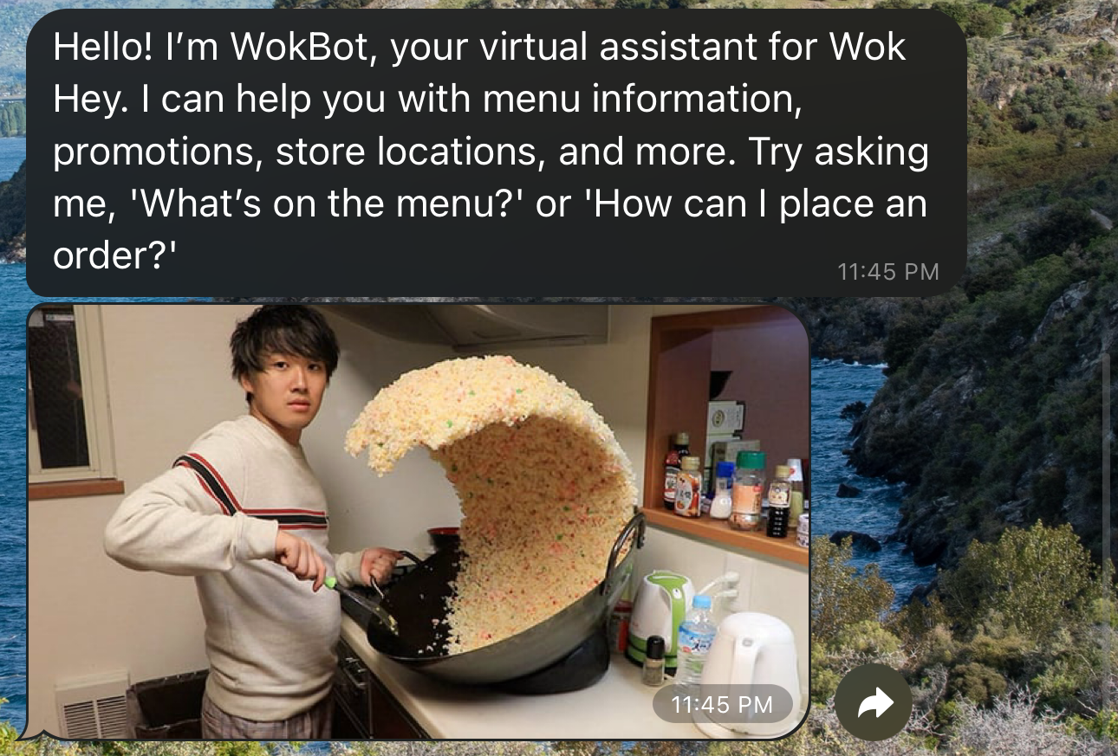
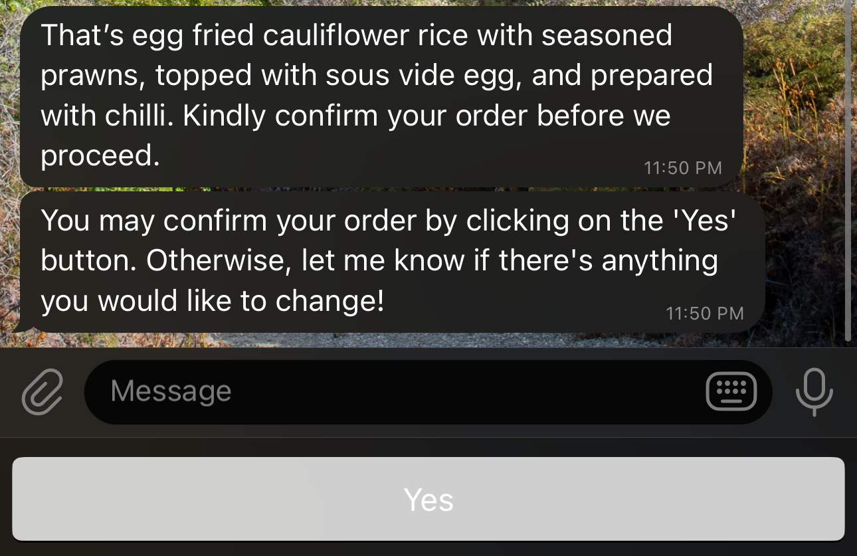
Rich Messages
Welcome
Quick Order
Quick Replies

Slide 16
06
Conclusion

Slide 17
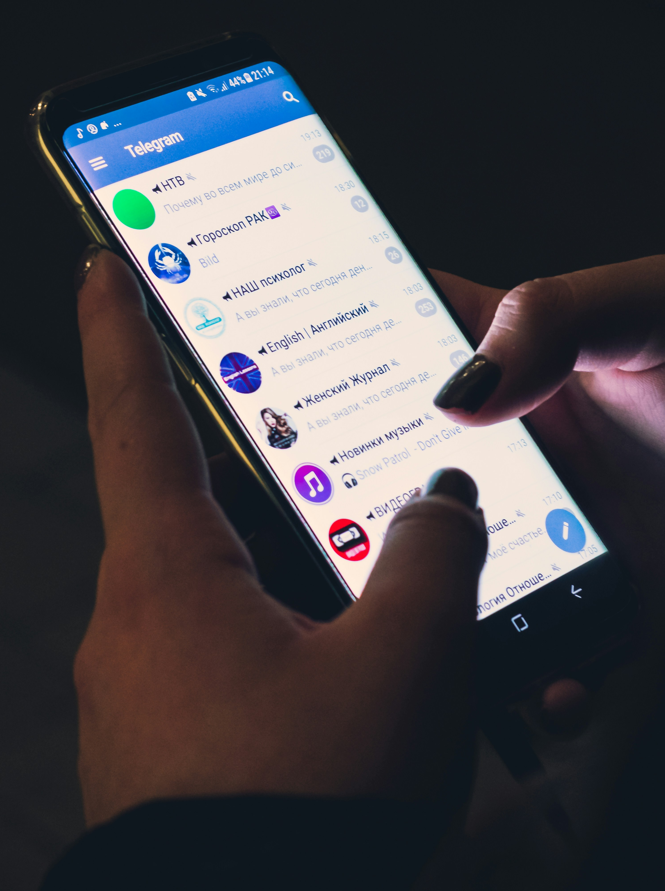
Conclusion
Wok Hey Bot provides a seamless and personal order experience, allowing users to browse the menu, make enquiries, and place remote orders for pickup or delivery. By reducing wait times and offering a personalised interaction, the bot enhances the overall convenience of ordering from Wok Hey.
Future work can look at enhancing the bot’s features with:
Dynamic Price Calculation: Incorporating fulfilment-based pricing to adjust costs dynamically based on factors such as location or order type (pickup or delivery).
Store Information Retrieval: Enabling real-time access to full addresses and opening hours of individual stores.

